Slide 1
Algorithms and Data Structures (CIS1002-N)
Week 1 – Lecture 2: Dynamic Arrays and Big-O Notation
Module Leader: Dr Annalisa Occhipinti
Email: A.Occhipinti@tees.ac.uk

Slide 2
A few things before we start
Any January starters?
Anyone who hasn’t done the Java module in semester 1?
Please stay behind at the end of this lecture.

Slide 3
Schedule
Week | Lecture (1hour) – Lab Session (2hours)
Week 1 | Introduction to Algorithms and their related Data-Structures – Array ADT
Week 2 | Sorting : Bubble sort, Selection sort and Shuttle sort
Week 3 | Sorting : Cocktail Shaker sort and Insertion sort, Introduction to O-notation
Week 4 | Singular Linked-lists
Week 5 | Doubly Linked-lists and Circular Linked-lists
Week 6 | Stacks
Week 7 | Queues
Week 8 | Recursion
Week 9 | Recursion
Week 10 | Recursion
Week 11 | Trees and balanced trees
Week 12 | Merge Sort and Quick Sort
Note: The schedule may be adjusted based on class progress.

Slide 4
Today’s plan
Dynamic Arrays: Inserting and Deleting Operations
Working with arrays
Big O-notation (if time)

Slide 5
A quick recap: why we need Data Structures
We need to operate on data.
We need a way to store this data.
We want to be able to perform abstract operations on this data:
adding a student to an enrolment database.
searching for a student with a certain name.
listing all students taking a certain module.
Data-structures are like the building blocks of algorithms.
Using abstract structures such as arrays, sets, lists, dictionaries, trees, graphs, etc
let us think algorithmically at a more abstract level.
But, using a poor choice of data structure or a poor choice of implementation of a data structure can make your algorithm behave increasingly worse!

Slide 6
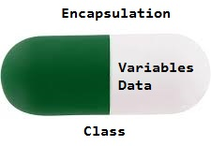
What is Encapsulation?
Technique for controlling the interaction between a program and its data structures.
It builds walls around a program’s data structures.
Such walls make programs easier to design, implement, read and modify.

Slide 7
Advantages of using encapsulation
Data Hiding: The user will have no idea about the inner implementation of the class. It will not be visible to the user that how the class is storing values in the variables. He only knows that we are passing the values to a setter method and variables are getting initialized with that value.
Increased Flexibility: We can make the variables of the class as read-only or write-only depending on our requirement. If we wish to make the variables as read-only then we have to omit the setter methods like setName(), setAge() etc. from the above program or if we wish to make the variables as write-only then we have to omit the get methods like getName(), getAge() etc. from the above program
Reusability: Encapsulation also improves the re-usability and easy to change with new requirements.
Testing code is easy: Encapsulated code is easy to test for unit testing.
Notes:
https://www.geeksforgeeks.org/encapsulation-in-java/

Slide 8
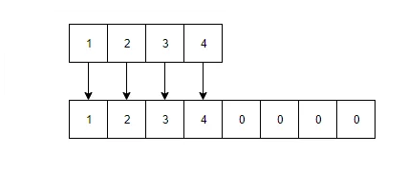
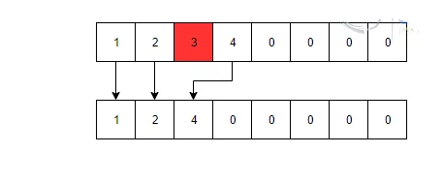
Dynamic Arrays
Add an element to a Dynamic array:
8
Remove an element from a Dynamic array:
Notes:
https://examples.javacodegeeks.com/dynamic-array-java-example/

Slide 9
Insertion – Algorithm
Need to know:
Max_Size: maximum number of components.
Size: number of components already stored.
Logic:
Insert ( Value, Index ) in Array[]

Slide 10
Insertion (1)
Insert element 12 at index position 5
12
0 1 2 3 4 5 6 7 8 9
12
3
6
23
80
45
18
10
?
?

Slide 11
Insertion (2)
Insert element 12 at index position 5
12
0 1 2 3 4 5 6 7 8 9
12
3
6
23
80
45
18
?
10
?

Slide 12
Insertion (3)
Insert element 12 at index position 5
12
0 1 2 3 4 5 6 7 8 9
12
3
6
23
80
45
?
18
10
?

Slide 13
Insertion (4)
Insert element 12 at index position 5
12
0 1 2 3 4 5 6 7 8 9
12
3
6
23
80
?
45
18
10
?

Slide 14
Insertion (5)
Insert element 12 at index position 5
?
0 1 2 3 4 5 6 7 8 9
12
3
6
23
80
12
45
18
10
?

Slide 15
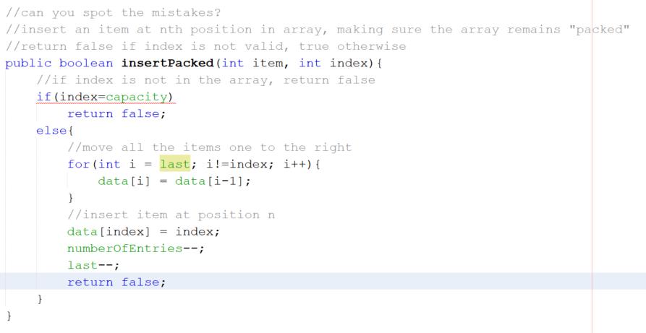
Spot the mistakes

Slide 16
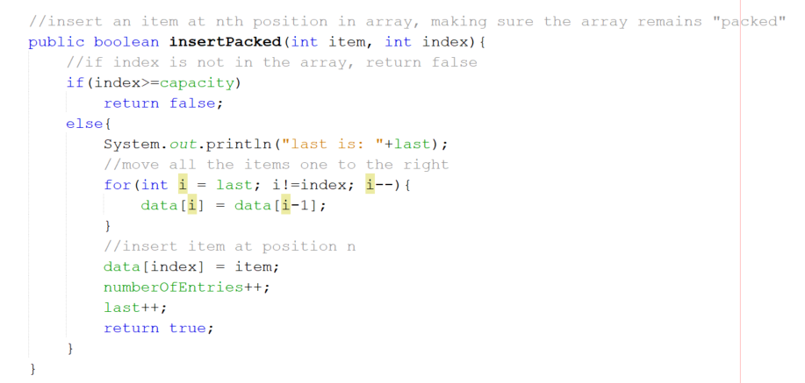
Solution

Slide 17
Insertion – Algorithm (2)
Your turn!
Write the pseudo-code to insert a value in an array at a particular index position making sure the array remains “packed”.
Assumptions:
Max_Size: maximum number of components.
Size: number of components already stored.
Insert ( Value, Index ) in Array[]
Share your solution on Padlet! https://padlet.com/a_occhipinti/1086vl4mjfcz

Slide 18
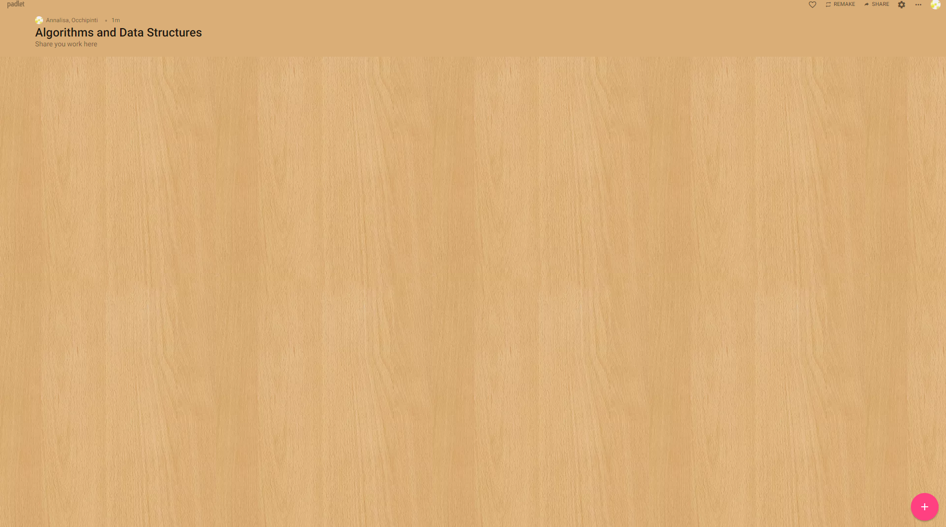
Share your idea on Padlet!
https://padlet.com/a_occhipinti/1086vl4mjfcz

Slide 19
Deletion – Algorithm
Need to know:
Max_Size: maximum number of components.
Size: number of components already stored.
Logic:
Delete ( Index ) in Array[]

Slide 20
Deletion (1)
Delete element at index position 4
0 1 2 3 4 5 6 7 8 9
12
3
6
23
80
12
45
18
10
?

Slide 21
Deletion (2)
Delete element at index position 4
0 1 2 3 4 5 6 7 8 9
12
3
6
23
?
12
45
18
10
?

Slide 22
Deletion (3)
Delete element at index position 4
0 1 2 3 4 5 6 7 8 9
12
3
6
23
12
12
45
18
10
?

Slide 23
Deletion (4)
Delete element at index position 4
0 1 2 3 4 5 6 7 8 9
12
3
6
23
12
45
45
18
10
?

Slide 24
Deletion (5)
Delete element at index position 4
0 1 2 3 4 5 6 7 8 9
12
3
6
23
12
45
18
18
10
?

Slide 25
Deletion (6)
Delete element at index position 4
0 1 2 3 4 5 6 7 8 9
12
3
6
23
12
45
18
10
10
?
Index position 8 will still contain previous value – delete if important

Slide 26
Deletion – Algorithm (1)
Assumptions:
Max_Size: maximum number of components.
Size: number of components already stored.
Delete ( Index ) in Array[]

Slide 27
Deletion – Algorithm (2)
Your turn!
Write the Java code to delete the value in an array at a particular index position making sure the array remains “packed”.
Assumptions:
Max_Size: maximum number of components.
Size: number of components already stored.
Delete (Index) in Array[]

Slide 28
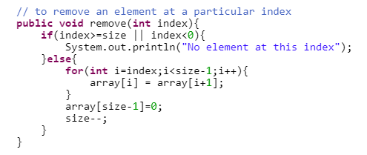
Dynamic Arrays in Java – Solution
Remove an element from a Dynamic array:
Notes:
https://examples.javacodegeeks.com/dynamic-array-java-example/

Slide 29
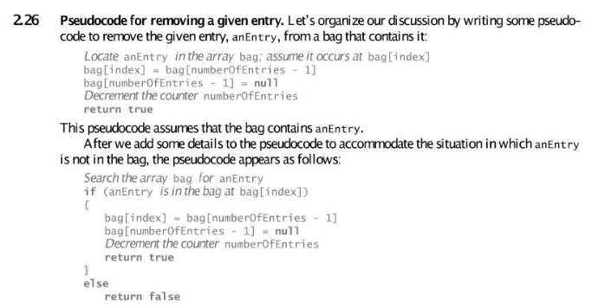
Notes:
From Carrano’s book

Slide 30
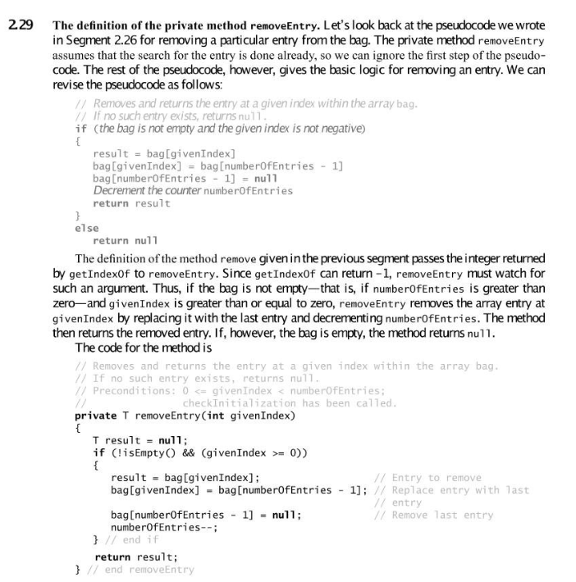

Slide 31
Expressing algorithms
Increasing ease of expression
Three possibilities:
Increasing precision
1. English
2. pseudo-code
3. a programming language

Slide 32
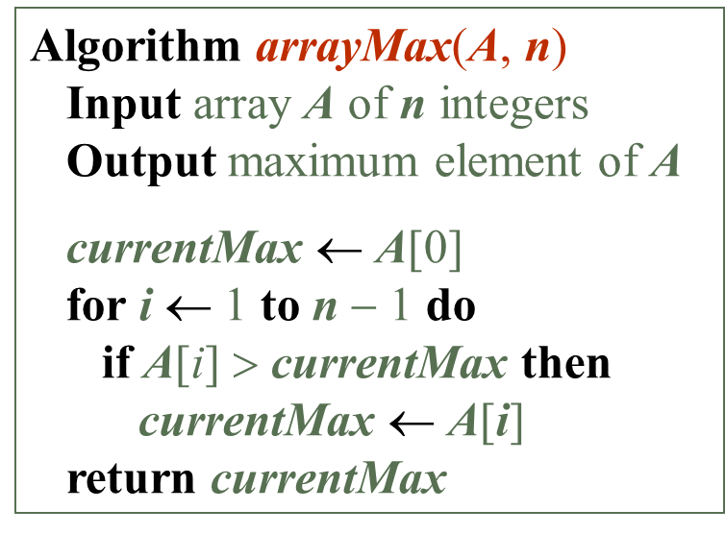
Expressing algorithms: Pseudo-code
Nice features of pseudo-code:
Pseudo-code represents a good balance between precision and readability.
Flexible - should be straightforward to translate to any programming language.
It’s intuitive - shouldn’t need to learn it.

Slide 33
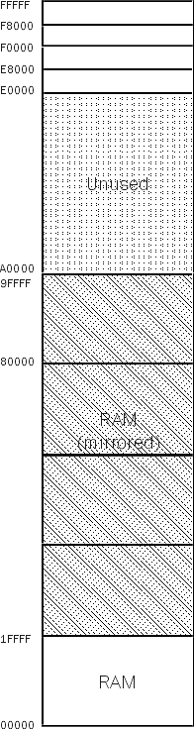
Memory Map

Slide 34
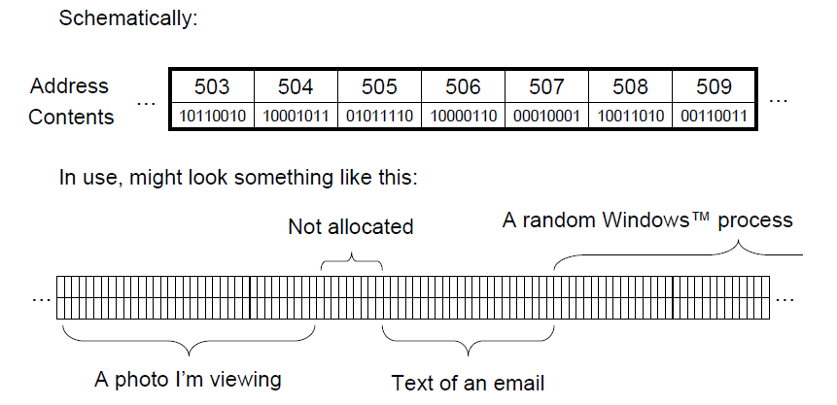
Physical Memory

Slide 35
But why do arrays start at 0?
Arrays start at 0 because we access
them by indexing them.
Your computer knows where arrays start in memory: where element 0 is. It works out the positions of the other elements. How? Like this:
It knows that every member of your array is a 32-bit integer (a number
stored as 32 0s or 1s). So let’s say 𝑛 = 32
It knows where your array starts in memory, for this example let’s say it starts at address 100, so 𝑜 = 100
It knows the index that you want to access, for this example, let’s say it’s index 2 (the 3rd element), so 𝑖 = 2
And so it needs to look at memory address…
𝑜 + (𝑛 × 𝑖)

Slide 36
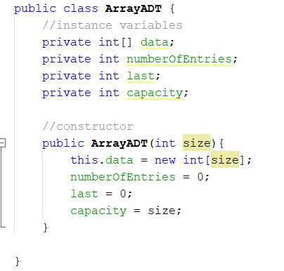
Example 1: Array ADT – a simple example
Data Type
Array Collection of actual components
NumOfEntries of the array (logical size)
Capacity number of components (physical size, capacity)
Last component index
Main methods
Boolean add(integer o): inserts a new element o – return false if the array is full
remove(integer i): removes the element at index i (replace it with zero)
isFull(): returns true if the array is full or false if not.

Slide 37
Example 2: Array ADT a more complex example
Data Type
Collection of actual components
Capacity max number of components (physical size)
NumOfEntries of the array (logical size)
Last component index
• Main methods
get(integer i): returns the element at index i without removing it
set(integer i, object o): replaces the element at index i with o and returns the old element
add(integer i, object o): inserts a new element o to have index i - added in Example 1
remove(integer i): removes and returns the element at index i - added in Example 1
• Additional methods
size(): returns the number of elements in this list
isEmpty(): returns true if this list contains no elements
getFrequencyOf(integer i): returns the number of times the integer i is in the array.

Slide 38
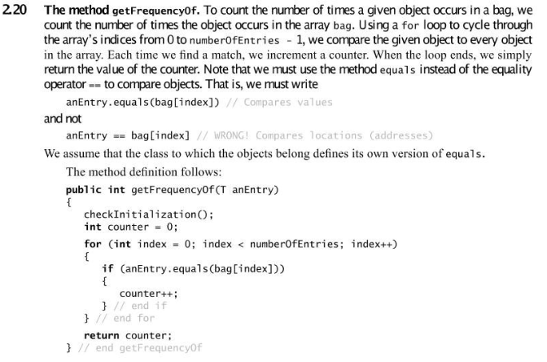
Possible solution to getFrequecy

Slide 39
Blackboard Quiz-Week 1
5 quick questions

Slide 40
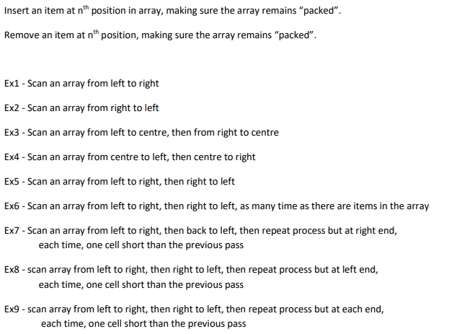
How would you implement these questions?

Slide 41
Exercises

Slide 42
Share your idea on Padlet!
https://padlet.com/a_occhipinti/1086vl4mjfcz

Slide 43

QUESTIONS?
a.occhipinti@tees.ac.uk

Slide 44
Big-O notation
“Order of”

Slide 45
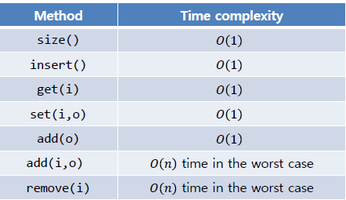
Big O notation and Dynamic Arrays
We’ll see Big O notations more in details in the next lessons but for now…
Describes an upper bound for the running time T(n) of an algorithm (worst case running time)
The O symbol was introduced in 1927 to indicate relative growth of two functions…
The running time of an algorithm typically grows with the input size.
Time Complexity:

Slide 46
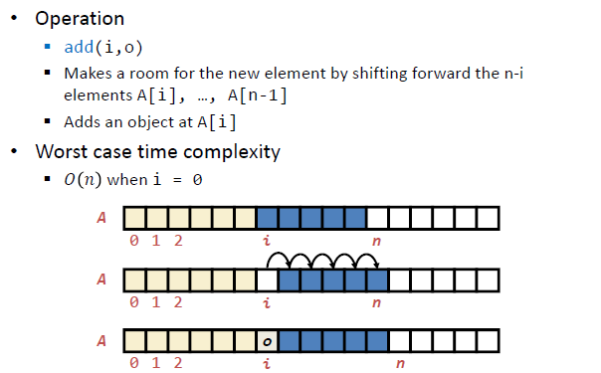
Time Complexity: Insertion

Slide 47
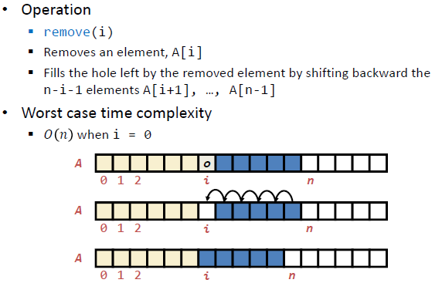
Time Complexity: Removing

